Slide 1
Location-Aware Adaptive Vehicle Dynamic System Simulation
Progress Report
Michael Fuller, Dirk Hortensius, Zach Roberts

Slide 2
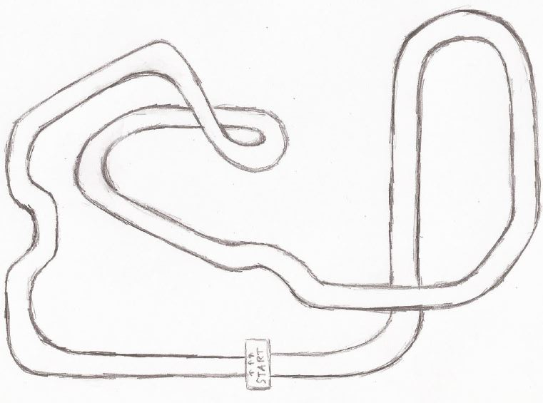
Progress to date
Meeting with VW was a success
Confirmed software choice
Drafts of Viewport and Track ready to produce

Slide 3
Upcoming Tasks
Obtain a license for Simulink 3D Animation to begin simulation development
Create custom 3D models for interior of vehicle and track
Map track position data to Matlab-readable dataset

Slide 4
Potential Issues
Software Issues
Unfamiliarity with development environment
Met with the Mathworks specialist teaching assistant recommended by you (client)
Getting Software
Before Tuesday, computer we were working with did not have Simulink
We are working with a soon-to-expire trial version of the 3D Animation Software

Slide 5
Potential Issues
Testing
Since our target audience is very experienced with vehicles, finding a comparable userbase to test our design with may be difficult
Not all the parts needed to test the intervention strategy have been provided

Slide 6
Milestones
Past Milestone: VW Presentation
Future progress is dependent on you (the client) purchasing software
Only deadline is a working simulation by the end of the semester, which needs
Track and Dashboard 3D Models
Input to vehicle simulation model
Realtime view updating to show information from the model

Slide 7
Stretch Goals
Force Feedback to Controller
“Ghost Car” of previous lap

